Slide 1
Project 1: Cookie Recipe
Group 7 : Aleena George, Anil Mathew, Arshdeep, Clinse Eldhose

Slide 2
Introduction
As part of project 1 for Web Design Development II, we have decided The Cookie Network as our website.
This is a social networking site where the user can share or view various recipes shared by other users in the site
Anyone can view the recipes without registering

Slide 3
Functionalities
The user can view the recipes, rate them and add comments as well, in the home page.
If the user likes to share their own recipe they can do it by selecting option ‘Add Recipe’ in the home page.
If the user likes to give samples, they can add the pickup location and the time slot for collecting as well in the share page.
The user should be either registered to share/view recipe or to add comment or rate other user’s recipes.
The user can search for recipes in their home with the recipe name or the author’s name.

Slide 4
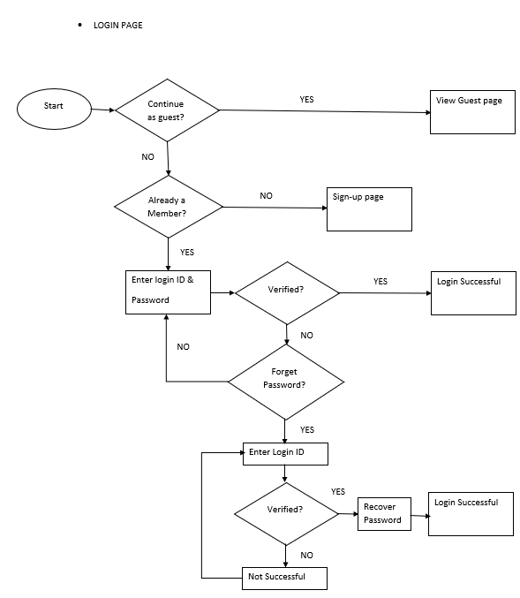
Use case Diagram: Login Page

Slide 5
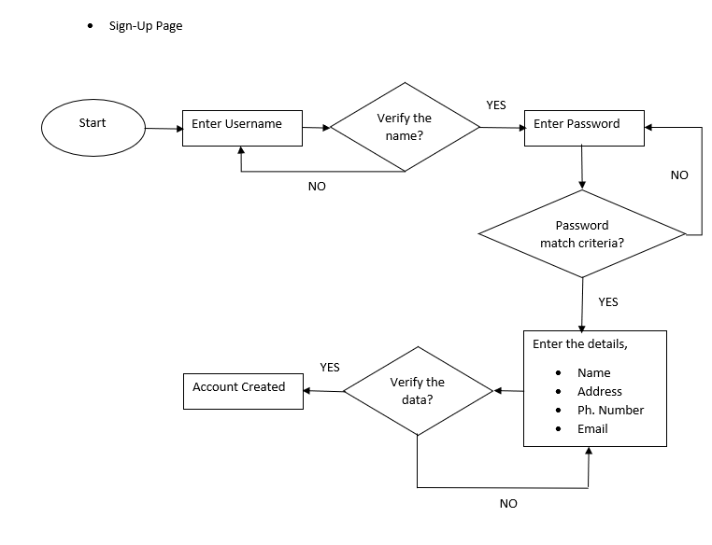
Use case Diagram: Registration Page

Slide 6
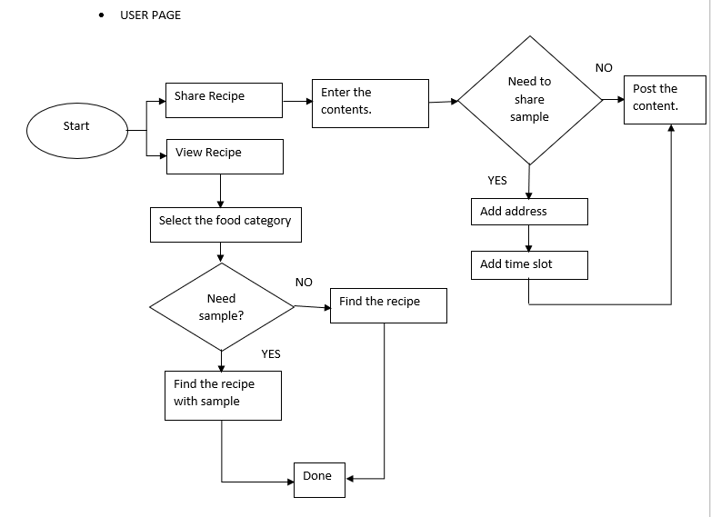
Use case Diagram: User Page

Slide 7
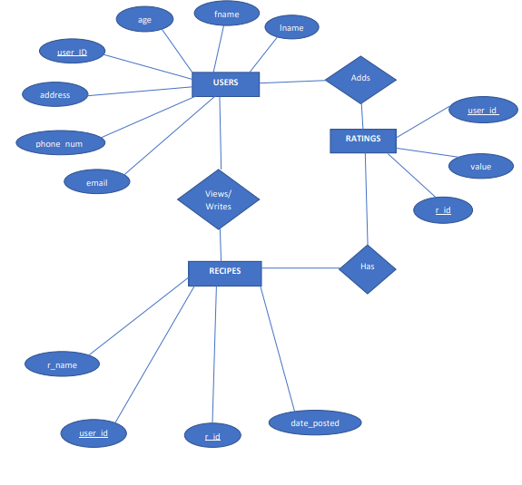
Entity-Relation Diagram

Slide 8
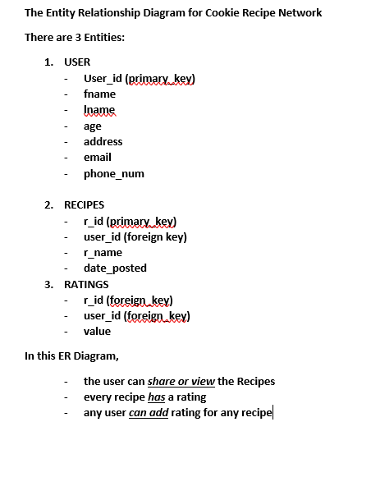
Entity-Relation Diagram : Desciption

Slide 9
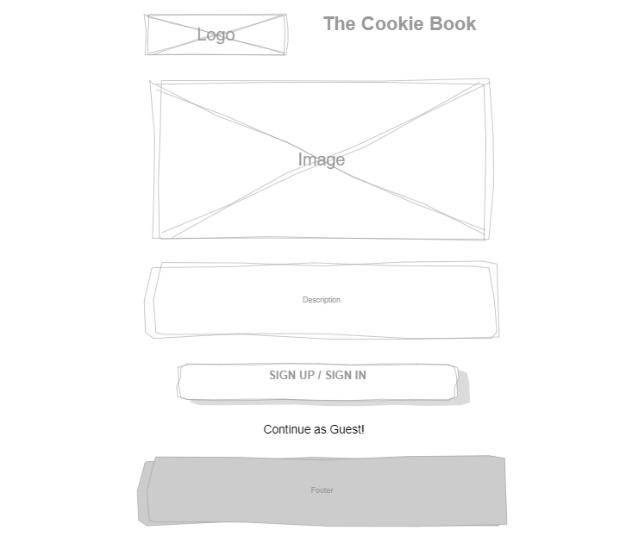
Wireframe: Login Page

Slide 10
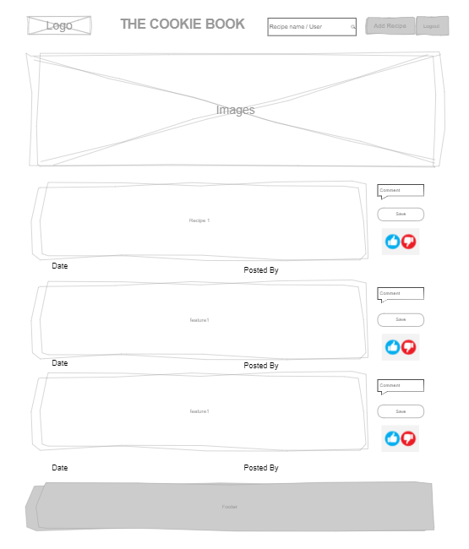
Wireframe: User Page

Slide 11
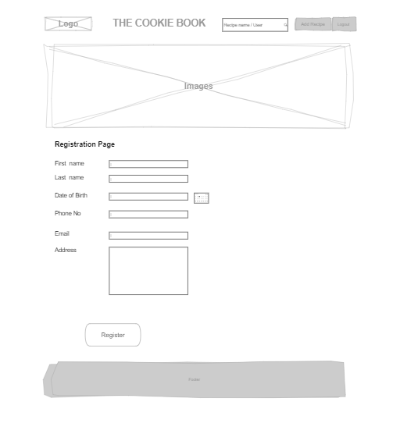
Wireframe: Registration Page

Slide 12
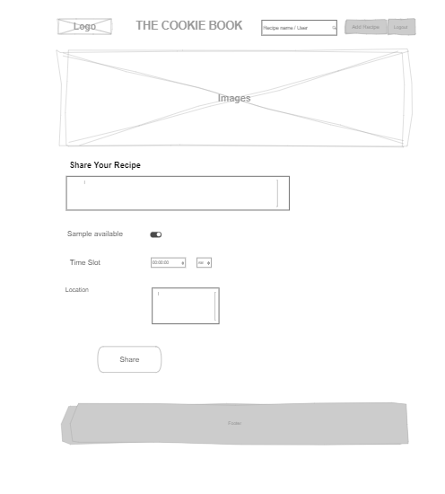
Wireframe: Share Recipe Page

Slide 13


